Slide 1
LearnR HOW TO’S
COMPENDIUM

Slide 2
HOW TO FILTER, SORT AND COUNT TABULAR DATA
The challenge .. Filter to select records, sort to reorder them, count to enumerate different types
The data .. Foodborne Outbreak Online Database (FOOD) tool of the Centers for Disease Control and Prevention (CDC) here
The tools .. library(data.table), DT[, Hmisc::cut2(…)], DT[grepl(..), ], DT[, .N, by=c(..)], DT[order(..)], DT[][]..
The recipe .. Write tests .. Read data, test size and class of object. test class and range of variables corresponding to query parameters .. Execute filter-sort-count to answer the primary question.
Just do it! .. Flesh out functions till tests pass
Keywords .. Use Ontology

Slide 3
HOW TO PIVOT TABULAR DATA
The challenge .. Pivots are the swiss-knife of data analysis and help elucidate trends and explore correlations.
The data .. Medieval crop yields in the UK here
The tools .. library(data.table), melt.data.table, dcast.data.table
The recipe .. Write tests .. Read data, test size and class of object .. Transform to data.table, test class and range of variables corresponding to query parameters .. Execute pivots to answer two primary questions, test results about who is the highest, etc.
Just do it! .. Flesh out functions till tests pass
Keywords .. Use Ontology

Slide 4

CHALLENGE: Which of the Bishop of Worcestor’s manors yield the most barley?
Pivots are the swiss-knife of data analysis and help elucidate trends and explore correlations.
Bruce Campbell has painstakingly assembled three centuries of English crop yields from 1211 to 1491. The data are available on the web here (registration required).
The data are organized by county, estate and manor for 19 different crops.
HOW TO PIVOT TABULAR DATA

Slide 5
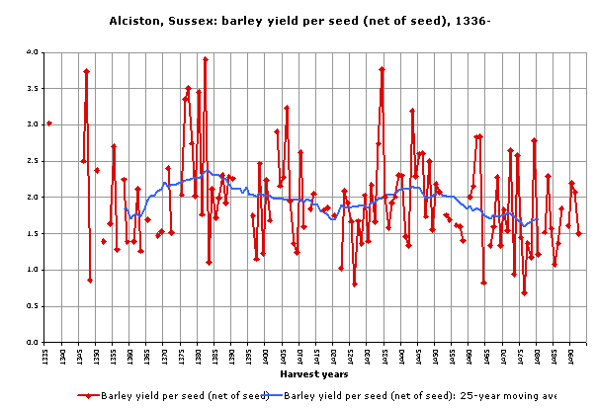
DATA: Yields (what:yield) for grains (which:grains) grown at the Bishop’s manors (where:manors) over years (when:years)
Query criteria
Years: 1270 – 1397
County: Gloucestershire
Grains: Wheat, Barley, Oats, Dredge, Legumes
What do you think happened here?
HOW TO PIVOT TABULAR DATA

Slide 6
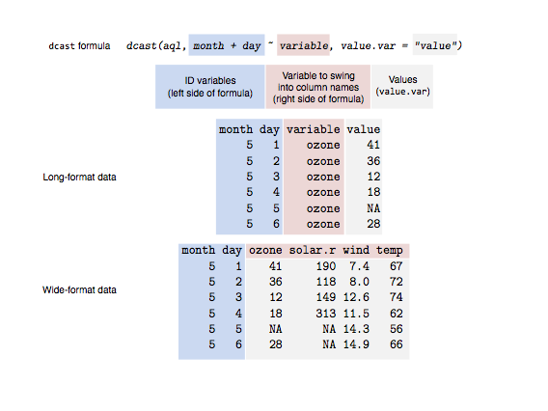
TOOLS: From the data.table package
Use:
library(data.table)
melt.data.table()
dcast.data.table()
Notes:
We use the melt and cast functionality for switching between long and wide forms of tabular data.
Reference:
1. To understand wide and long forms, refer to this tutorial by Sean Anderson here.
HOW TO PIVOT TABULAR DATA

Slide 7
RECIPE: Do and test that..
Read data in tabular form
Spreadsheet is loaded into data.frame
Data are stashed in data.table
Subselect on estate and pivot on manor for mean of selected crop yield
Bishop's manors have similar yields
Switch to long for each manor for each year, measuring yield for each of five crops. Pivot on manor for count of years in which data are available.
Bourton on the Hill has most years of data available across crops
Cleeve has the least years of data available across crops
HOW TO PIVOT TABULAR DATA

Slide 8


Slide 9
HOW TO PIVOT TABULAR DATA
The challenge .. Pivots are the swiss-knife of data analysis and help elucidate trends and explore correlations.
The data .. 2016 Presidential Campaign Finance from Federal Election Commission here
The tools .. library(data.table), melt.data.table, dcast.data.table
The recipe .. Write tests .. Read data, test size and class of object .. Transform to data.table, test class and range of variables corresponding to query parameters .. Execute pivots to answer two primary questions, test results about who is the highest, etc.
Just do it! .. Flesh out functions till tests pass
Keywords .. Use Ontology

Slide 10

CHALLENGE: How are candidates doing in financing their campaigns for the U.S. presidential race?
Pivots are the swiss-knife of data analysis and help elucidate trends and explore correlations.
The Federal Election Commission regulates the financing of U.S. federal elections. Candidates are required to disclose details of their campaign finance. The data are available for download on their website here.
The data has contributions to the 2016 U.S. presidential race organized by location and date among other variables.
HOW TO PIVOT TABULAR DATA

Slide 11
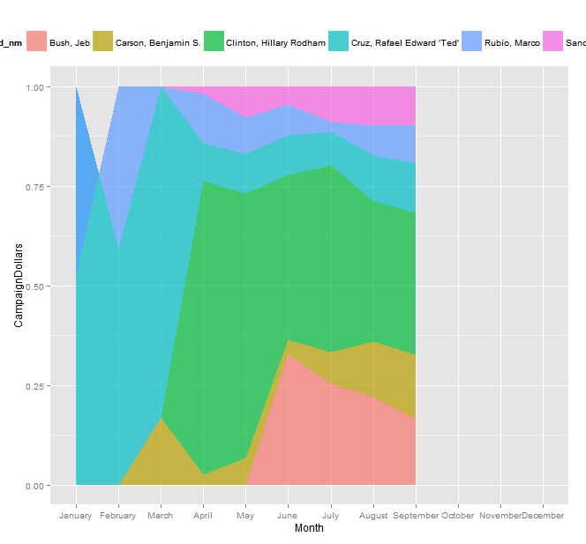
DATA: Who (who:candidates) received how much (how much:dollars) in campaign contributions and where (where:state)?
Fields
Candidates: 21
Timeline: Until September, 2015
States: US States & Territories
File: P00000001-ALL_.csv
Who got off to an early start?
HOW TO PIVOT TABULAR DATA

Slide 12
TOOLS: From the data.table package
Use:
library(data.table)
melt.data.table()
dcast.data.table()
Notes:
We use the melt and cast functionality for switching between long and wide forms of tabular data.
Reference:
1. To understand wide and long forms, refer to this tutorial by Sean Anderson here.
HOW TO PIVOT TABULAR DATA

Slide 13
RECIPE: Do and test that..
Read data in tabular form
Spreadsheet is loaded into data.frame
Data are stashed in data.table
Summarize total campaign finance raised by candidates and execute a Pareto to identify front-runners
Candidates have raised over USD 100 M
Switch to wide form for month-on-month summaries by candidate. Then long form to visualize results.
Hillary has raised the most money so far
Campaign contributions peaked in June
Clinton and Sanders among top-grossing candidates and not Trump (by Pareto)
Trump, Carson, Rubio among candidates.
Rand Paul started off early and dropped out
HOW TO PIVOT TABULAR DATA

Slide 14
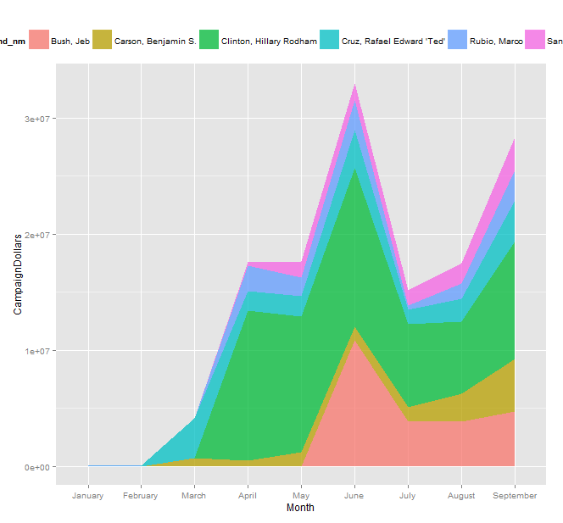
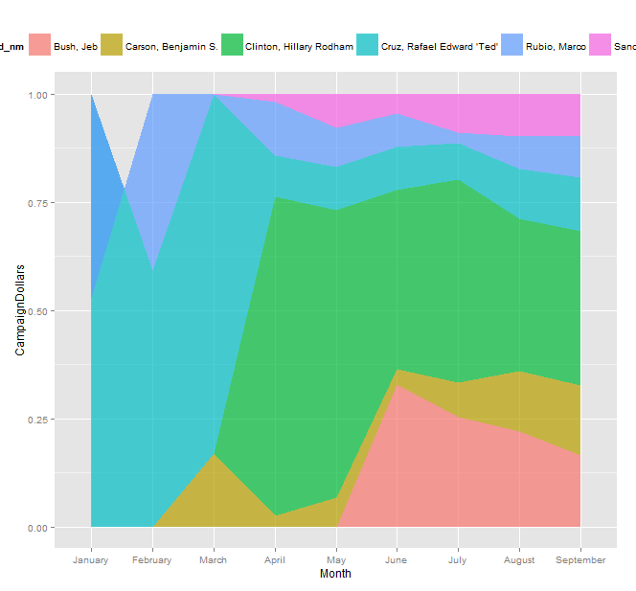
JUST DO IT! TOP GROSSING CANDIDATES & EARLY BIRD
Clinton and Sanders among top-grossing candidates.
Some candidates started off earlier than others.

Slide 15
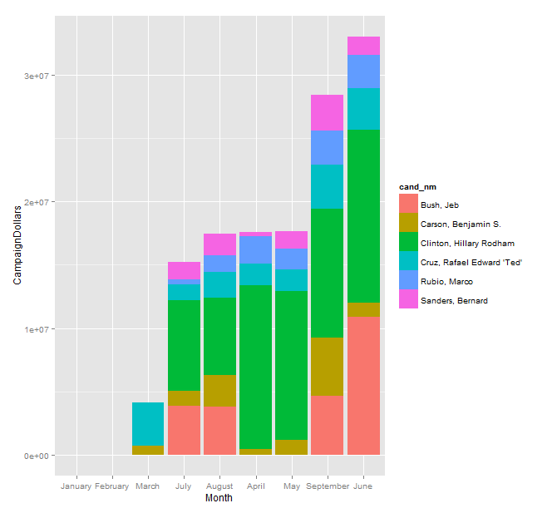
JUST DO IT! TOP GROSSING MONTH
June was the top-grossing month until September 2015, followed by September.
Clinton and Bush, along Ted Cruz, Carson, Rubio and Sanders led the pack.

Slide 17
Includes ..
How to convert date from a string to an object
How to update a column in a spreadsheet
How to apply the split-apply-combine pattern to extract statistical summaries from a spreadsheet
How to chain successive operations on a spreadsheet
How to reorder the rows in a spreadsheet by sorting on one or more columns
How to sort on a factor
How to sort on calendar months
How to calculate cumulative sum over column entries

Slide 18
Backup
NOT FOR USE

Slide 19
HOW TO VECTORIZE A FUNCTION
The challenge .. Default behavior of R functions
The data .. mtcars dataset
The tools .. Vectorize()
The recipe .. Write tests, write a function, pass it to Vectorize()
Just do it! .. Flesh out functions till tests pass
Keywords .. Use Ontology

Slide 20
FORMAT
The challenge .. ubiquity of pivots
The data .. mtcars dataset
The tools .. data.table
The recipe .. Breakdown a pivot, map different components
Just do it! .. Execute
Keywords .. Use Ontology

